Slide 1
view,index
Shenwei

Slide 2
Today’s lecture
View
Index
transaction

Slide 3
Views
A view is a relation defined in terms of stored tables (called base tables ) and other views.

Slide 4
Why use views?
Hide some data from some users
Make some queries easier / more natural
Real applications tend to use lots and lots (and lots and lots!) of views

Slide 5
declare view in sql
Create View Vname As
<Query>

Slide 6
example
construct the following view
who are both executives and stars
create view starexec as
select moviestar.name,moviestar.address,gender,birthdate,cert,networth
from moviestar,movieexec
where moviestar.name=movieexec.name

Slide 7
query a View
Query a view as if it were a base table.
Example query:
get the female stars who are also an executive
select name from starexec
where gender='F'

Slide 8
modify VIEW in sql
drop View Vname

Slide 9
Rename attribute
Create view viewname(a1,a2..) as
Select statement

Slide 10
updatable views
suppose the views are from R
where clause:no R relation
from clause:only R relation
attributes:enough
views are updatable

Slide 11
modify VIEW in sql
insert into Vname
values(<value list>)
update Vname
set attribute=new value
delete from Vname
where condition

Slide 12
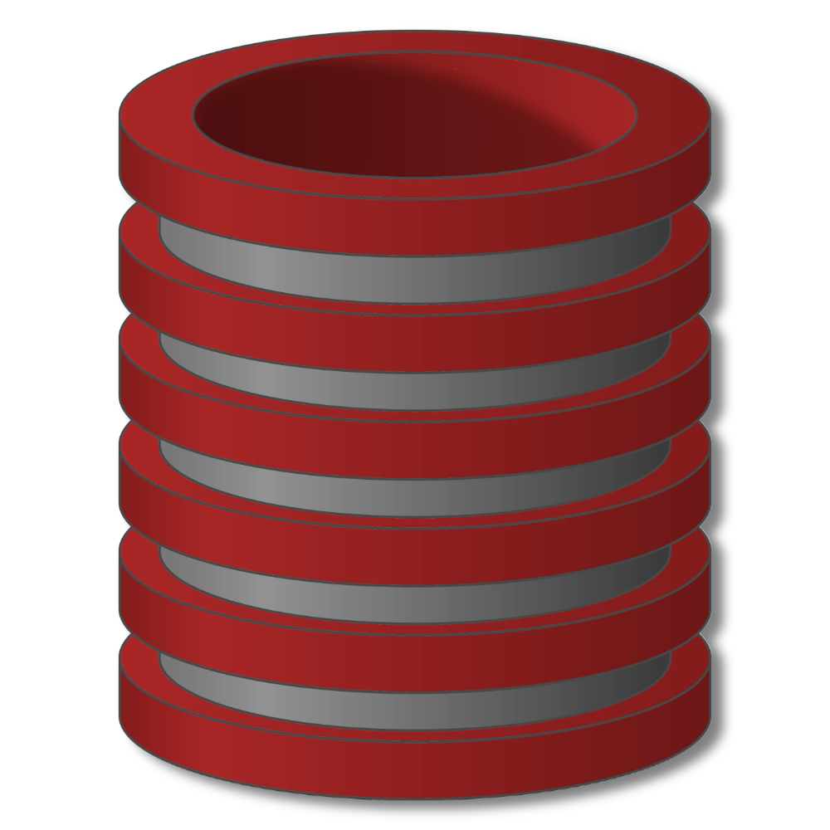
Indexes

Slide 13
Indexes
Index = data structure used to speed access to tuples of a relation, given values of one or more attributes.
Could be a hash table, but in a DBMS it is always a balanced search tree with giant nodes (a full disk page) called a B-tree.
immediate location of tuples

Slide 14
Indexes
Indexes
Primary mechanism to get improved performance
on a database
Persistent data structure, stored in database
Many interesting implementation issues
But we are focusing on user/application perspective

Slide 15
Indexes
Functionality
T
Index
on T.A
 | A | B | C
1 | cat | 2 | …
2 | dog | 5 | …
3 | cow | 1 | …
4 | dog | 9 | …
5 | cat | 2 | …
6 | cat | 8 | …
7 | cow | 6 | …
 | … | … | …
SELECT *
FROM T
WHERE T.A='cow'

Slide 16
Indexes
Functionality
T
Index
on T.A
 | A | B | C
1 | cat | 2 | …
2 | dog | 5 | …
3 | cow | 1 | …
4 | dog | 9 | …
5 | cat | 2 | …
6 | cat | 8 | …
7 | cow | 6 | …
 | … | … | …
Index
on T.B
SELECT *
FROM T
WHERE T.B=2

Slide 17
Indexes
Functionality
T
Index
on T.A
 | A | B | C
1 | cat | 2 | …
2 | dog | 5 | …
3 | cow | 1 | …
4 | dog | 9 | …
5 | cat | 2 | …
6 | cat | 8 | …
7 | cow | 6 | …
 | … | … | …
Index
on T.(A,B)
Index
on T.B
SELECT *
FROM T
WHERE T.A='cat' and T.B>5

Slide 18
Indexes
Utility
Index = difference between full table scans and
Orders of magnitude performance difference
Underlying data structures
Balanced trees (B trees, B+ trees)
Hash tables

Slide 19
Declaring Indexes
No standard!
Typical syntax:
CREATE INDEX studioInd ON
movies(studioname);
CREATE INDEX movieInd ON
movies(title,year);

Slide 20
Indexes
Select title,year
From movies
Where studioName = ‘Fox’
Select *
From movies
Where title = ‘stars war’ and year=1977

Slide 21
Delete index
DROP INDEX indexname

